Slide 1

Force Majeure in a COVID 19 World
Chris Starkey
November 12, 2020

Slide 2
Force Majeure - General
What is force majeure?
  “Force majeure” is a contract provision that excuses a party’s performance of its obligations under the agreement when certain circumstances beyond that party’s control arise, making performance inadvisable, commercially impracticable, illegal or impossible.

Slide 3
Force Majeure - General
No universal language
  There is no one phraseology for this clause, and subtle differences in the specific language may impact its application to a given situation, the level of protection that it affords, and other requirements attendant to it being invoked.
Key elements:
  use of a generic description followed by a non-exclusive list of specific circumstances
  mutuality/bilateral availability
  time-specific constraints
  positioning as a preface to negotiation and compromise versus outright contract termination.

Slide 4
Force Majeure – AmFam Template Language
“Neither party will be liable for failure or other delay in performance of the obligations under this Agreement and such failure or delay will not constitute a breach under this Agreement to the extent such failure or delay is due to circumstances beyond its reasonable control, including acts of God (fires, floods, storms, hurricanes, earthquakes, tornadoes, etc.), epidemics, pandemics, acts of public enemy, war, civil disturbance, sabotage, accidents, insurrections, blockades, embargoes, acts of any governmental or quasi-governmental authority, threat or act of terrorism, labor strikes, lock-outs or other labor disturbance or interruption, government warnings or advisories or any other force majeure (collectively, “Force Majeure Events” and individually, a “Force Majeure Event”). If a Force Majeure Event prevents Contractor from fulfilling any of its obligations to American Family set forth in this Agreement, then the performance of such will be excused and the parties will attempt in good faith to remedy the failure or delay. Notwithstanding the preceding sentences, if a Force Majeure Event results in the failure or delay which cannot be rectified to the parties’ satisfaction within 60 days of the Force Majeure Event, then American Family will have the option, in American Family’s sole discretion, of either extending the Term of this Agreement for a reasonable time period to be mutually agreed upon by the parties or terminating this Agreement and receiving a pro rata refund of compensation paid.”

Slide 5
Force Majeure – COVID Threshold Questions
Which party is invoking force majeure?
COVID impacts on supplier performance:
  Cancellation
  Temporary suspension of services
  Alteration of performance standards
For COVID purposes, the keys with respect to a given force majeure clause are:
  What language is used in the performance standard and how high is the bar set?
  Is epidemic/pandemic included in the list and has there been a formal government/other authority declaration in a location that impacts the asserting party?

Slide 6
Force Majeure – COVID Threshold Questions
Base standard
  Can range from very forgiving to extremely stringent
Contract A:
  “Either party may terminate its performance obligations without liability to the extent its performance is affected by acts or occurrences beyond its control that makes it impossible to hold the Program or for [Supplier] to provide the services specified herein.”
Contract B:
  “The performance of this Agreement is subject to any circumstance making it inadvisable, illegal or impossible to provide or use the Hotel facilities, or creating a significant risk to participant health or safety, including […] or any other extraordinary occurrence in either the program destination or the Customer’s point of origin that are outside the control of the canceling party.“

Slide 7
Force Majeure – COVID Threshold Questions
Specific circumstances
  “Epidemic or pandemic” language is important but not determinative
    Such language is now fairly standard, even before COVID
  “Government shutdown” language can also help here
  If no specific references, is there other applicable “catch all” language?
Government/other authority declaration
  Federal
  State
  Local
  WHO

Slide 8
Force Majeure – All or Nothing Application?
For some contracts, a party may be seeking to use force majeure to terminate the agreement outright and recoup pre-payments or avoid future committed payment obligations to the extent possible.
  Example: Event-related contracts, with associated travel, lodging, and catering needs
For other agreements, the asserting party may be seeking to either excuse temporary non-performance, or to “pause” or suspend the contracted services until such time as the services may be safely resumed.
  Example: Facilities maintenance contracts in current work-from-home environment

Slide 9
Force Majeure – Using as Negotiating Tool
Force majeure language rarely determinative on its face.
  Often difficult to predict how court would rule, and strong “proximate cause” evidence will be required
  Underdeveloped body of law specific to COVID and force majeure
  One component of a larger overall discussion with supplier
  Favorability of the force majeure language impacts leverage
  Negotiated compromise is always optimal result
Examples

Slide 10
Force Majeure – Additional Considerations
Notice
  What requirements does the clause contain, if any, around notification being provided in proximity to awareness of the force majeure event?
  Example: “This Agreement may be terminated without liability for any one of such reasons by written notice from one party to the other within ten (10) days from the Force Majeure act or occurrence.”
  Problematic application to COVID
Governing Law
  Separate section of agreement that may impact parties’ respective amounts of leverage
  Example: China “force majeure permits” to attempt to shield Chinese shippers from contractual liability
  Different jurisdictions apply different standards to force majeure

Slide 11
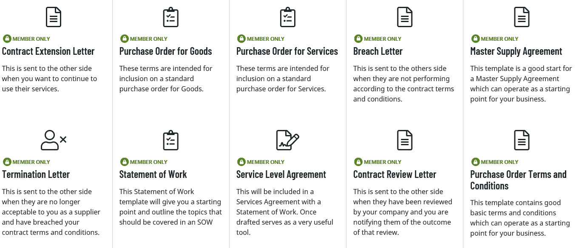
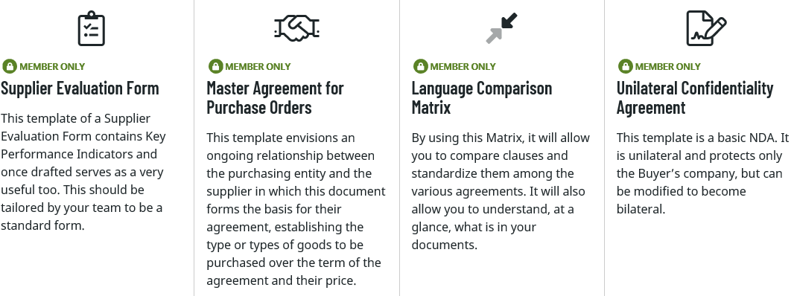
Force Majeure – ISM Template Resources

Slide 12
Force Majeure – ISM Template Resources
https://www.ismworld.org/for-individuals/tools-resources/resources-templates/
Questions?

